Slide 1
PID algorithm

Slide 2
PID algorithm
P - proportional
I - integral
D - derivative
around since 1930s

Slide 3
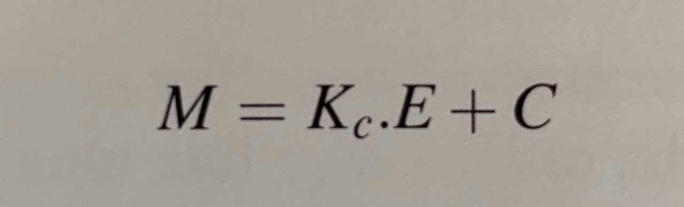
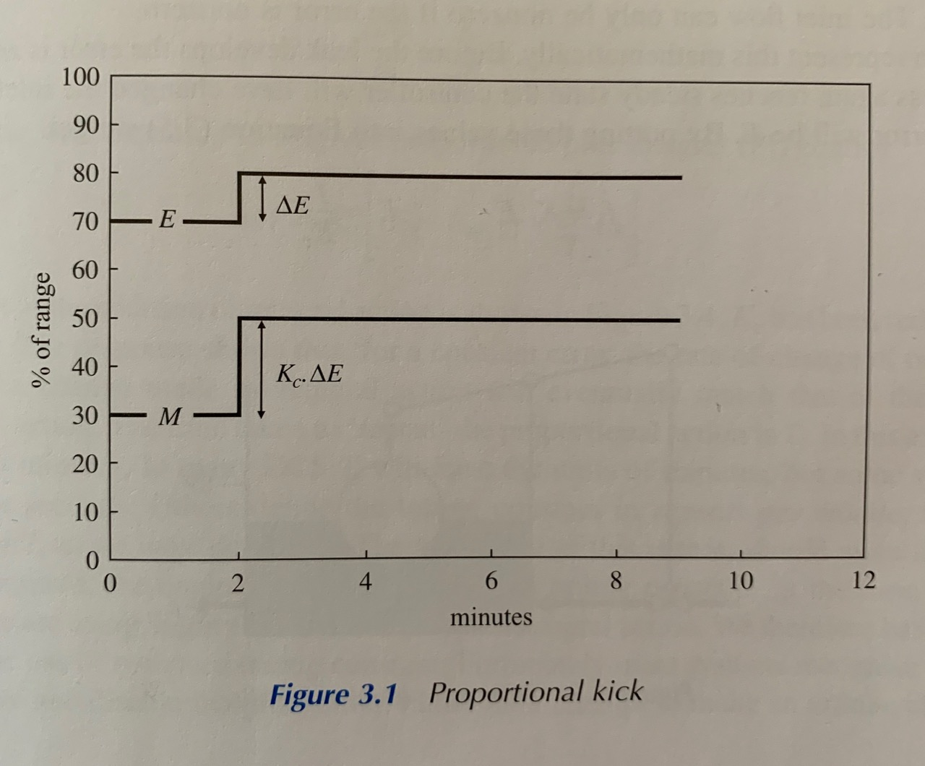
Proportional action
Notes:
The principle behind proportional control is to keep controller output (M) in proportion to the error (E).
Kc is the controller gain and is a tuning constant set by control engineer. Term C is necessary because it is unlikely that zero error coincides with zero controller output.
The Control algorithm includes additional engineer-defined parameter called action. It can be set into direct mode which will increase the controller output as the process variable increases or reverse mode which will decrease the controller output when process variable increases.

Slide 4
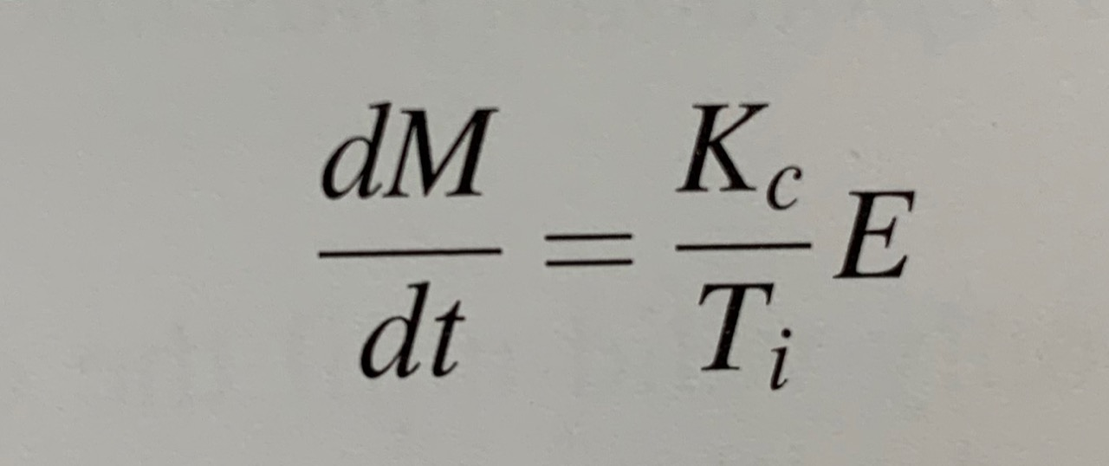
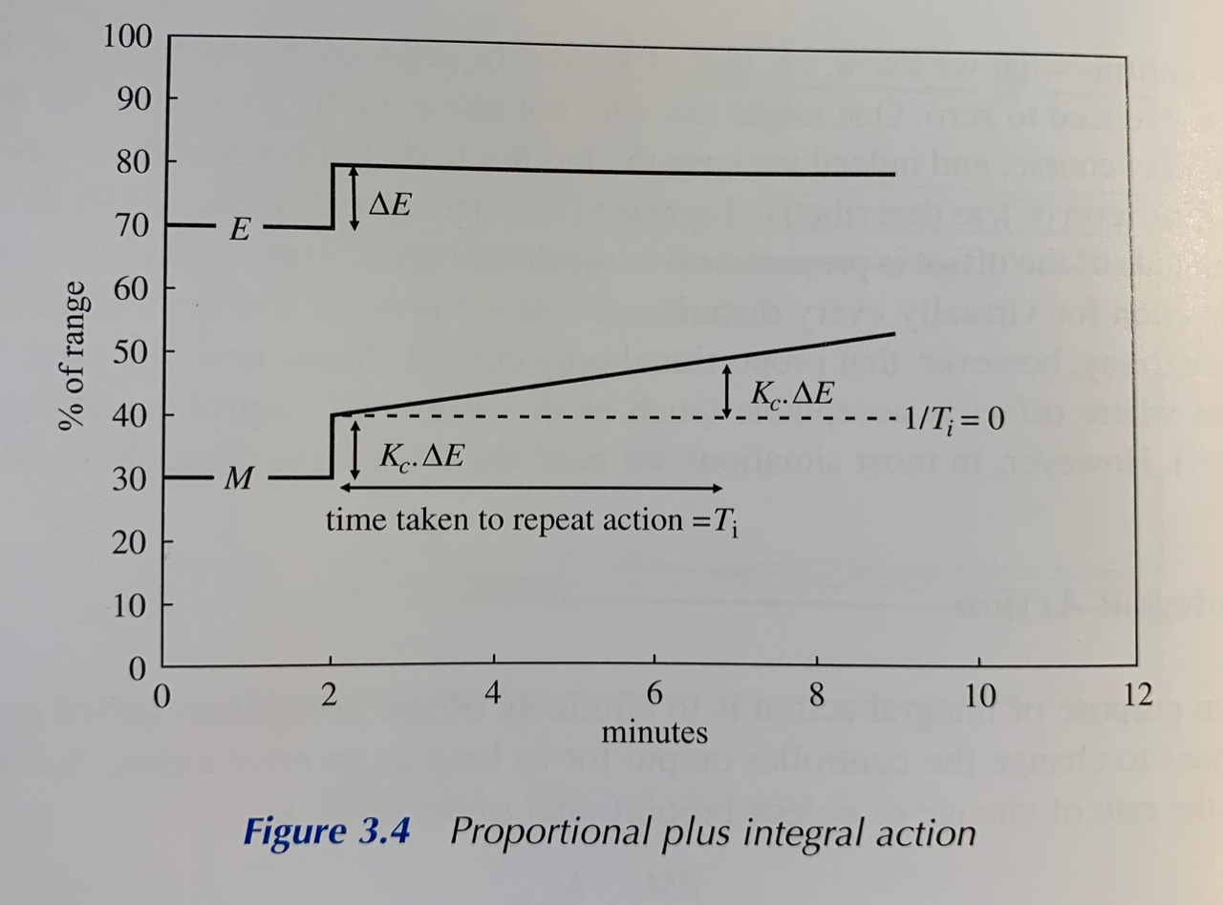
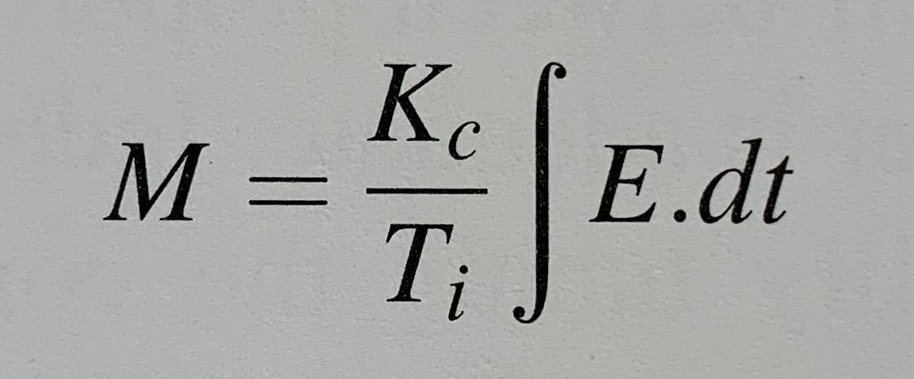
Integral action
Notes:
The main purpose of integral action is to eliminate offset. Sometimes called reset action it continues to change the controller output for as long as an error exists. It does this by making the rate of change of output proportional to the error.
Ti is known as the integral time and is the means by which the engineer can dictate how much integral action is taken. Integrating the equation above gives the action its name.
The effect of integral action is shown in the graph
The response shows, that for constant error, the rate of change of output is constant. The change of integral action will eventually match that of the initial proportional action. The time taken to repeat the proportional action is Ti. In this example, Ti is about 5 minutes. In many distributed control systems, Ti will have the units of minutes, but some systems use hours or seconds.

Slide 5
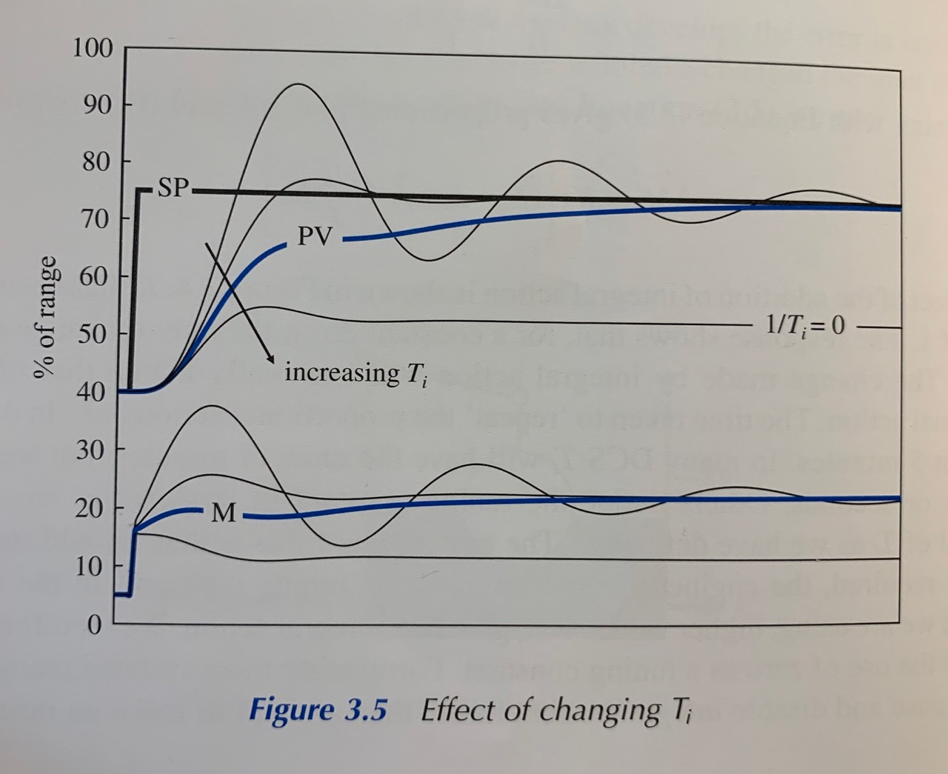
Integral action
Notes:
Even small amount of integral action will eliminate offset. Attempting to remove it too quickly will, as with any control action, cause oscillatory behaviour. However this can be compensated for by reducing controller gain Kc. Optimum controller performance is a trade-off between proportional and integral action.

Slide 6
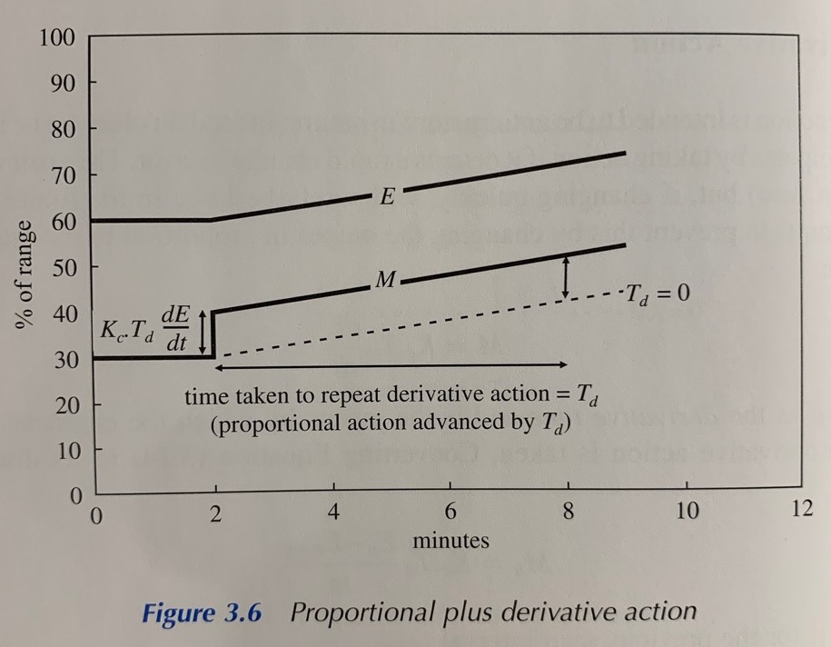
Derivative action
Notes:
Derivative action is intended to be anticipatory in nature - it anticipates by taking action if it detects a rapid change in error. The error may be very small (even zero) but, if changing quickly, will surely be large in the future. Derivative action attempts to prevent this by changing the output in proportion to the rate of change of error.

